Slide 1

OGC ISG Sprint Kickoff Presentation:
Jordan Dauble, Owner Glen Johnson, Principal Software Developer
September 1, 2020

Slide 2

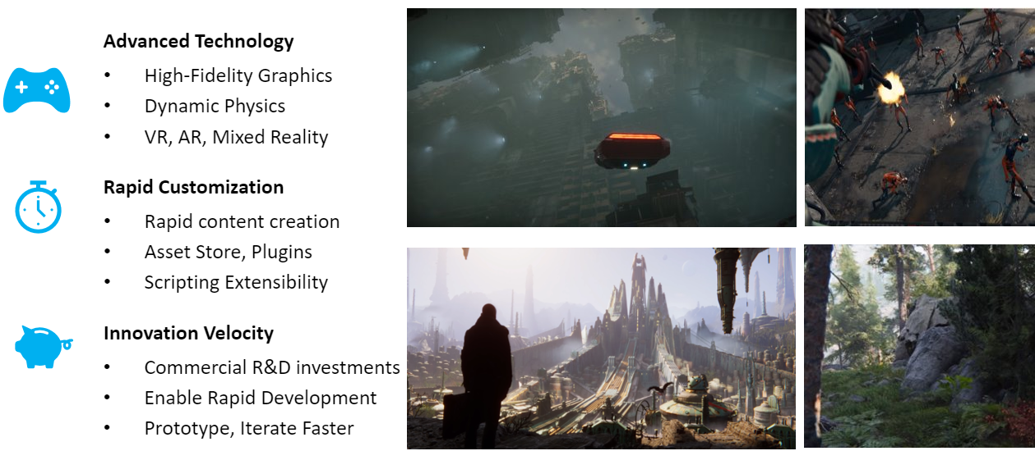
CDB Terrains in Unity

Slide 3
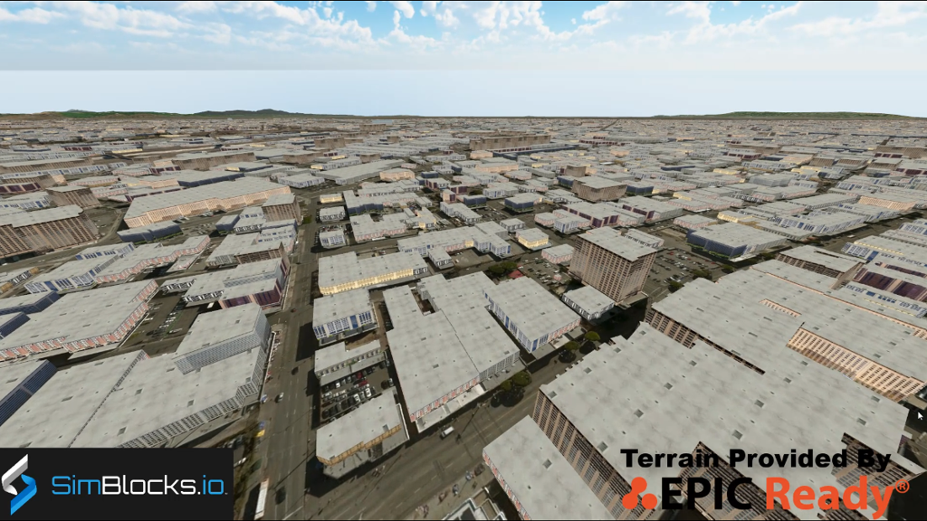
CDB Terrains in Unity

Slide 4
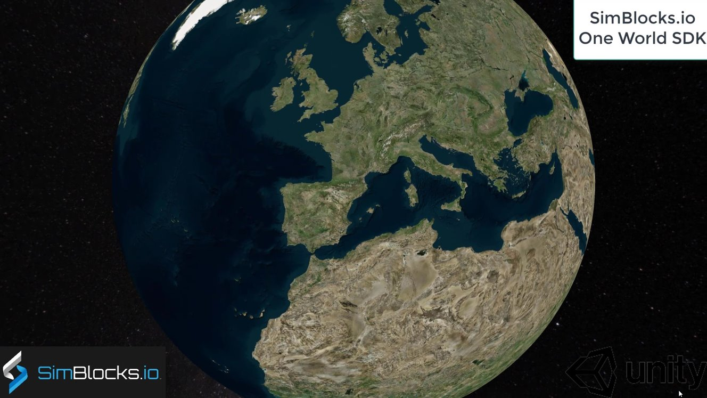
One World SDK for Unity

Slide 5
Proposed Activites
Test models from multiple servers
Identify model processing issues.
Identify performance bottlenecks.
Identify model loading and rendering optimizations.
Implement selected features of OGC API – GeoVolumes draft specification
Support loading 3D geospatial data in One World SDK for Unity.
Investigate bounding volume scale and shape tradeoffs.
Investigate potential issues with Virtual Reality device deployment.
Stretch Goals
Investigate the feasibility of integrating the OGC API – GeoVolumes with Unreal Engine 4 utilizing a streaming CDB capability.

Slide 6
Presentation Tips (delete this slide from your preso)
The primary audience = the other Participants.
Identify which (if any) testing work in the Pilot you intend to build upon.
Recommendation: reference the Pilot ERs:
D001 3D Data Container ER (aka Pilot Implementation Experiences): https://portal.ogc.org/files/?artifact_id=94028.
D002 OGC API - GeoVolumes ER (aka Draft Specification): https://portal.ogc.org/files/?artifact_id=94029.
D003: Pilot Summary ER (aka Extended Executive Summary): https://portal.ogc.org/files/?artifact_id=94030.
Identify which part(s) of the API – GeoVolumes Draft Spec do you intend to cover.
(You’ll be required to address this in your Sprint Report deliverable #1 anyway.)
Identify the closest scenario(s) to the work you intend to perform.
(Will your implementation address the scenario directly? If not, how will it differ?)

Slide 7







The end.
Building Blocks for High Fidelity Simulations
THANK YOU!
Jordan Dauble, Owner
Jordan.Dauble@SimBlocks.io
Glen Johnson, Principal Software Developer
Glen.Johnson@SimBlocks.io
​

